Slide 1

ICICI Bank Management System
Bhavesh Khanchandani
© All rights reserved by Fireblaze Technologies Pvt. Ltd.

Slide 2
Problem Statement
Create a Bank Management System which has Multiple tables and relationships between the tables depending on the constraints which we are passing to connect the different tables.
By using this database we will retrieve the information of particular customers and employees who are working in the bank. In this database, we will create a view also for a customer and the employees in the bank.
The Bank wants to build the database for their customer and employees with all the details like creating an account in a bank type of account which helps the bank to retrieve the data on one click so they can find out the day to day update easily on their database.
© All rights reserved by Fireblaze Technologies Pvt. Ltd.

Slide 3
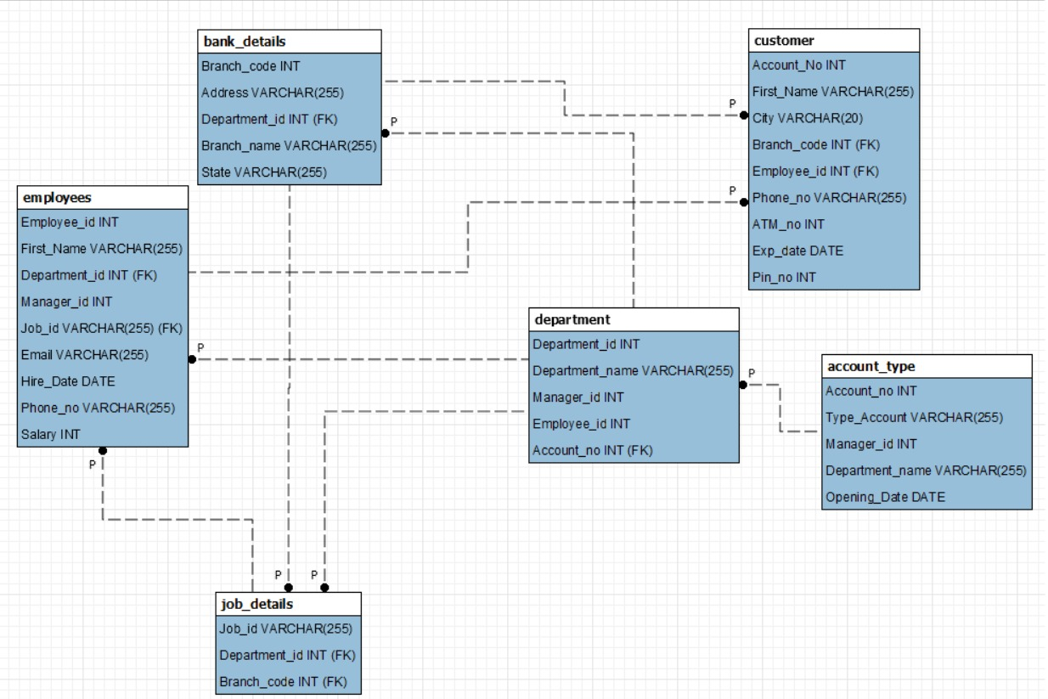
About the Data
Tables in the Data
Employees
Department
Bank_Details
Account_type
Job_details
Customer
© All rights reserved by Fireblaze Technologies Pvt. Ltd.

Slide 4
Proposed Solution
There are six tables in the database which we have to create in our schema
● Step 1 Create a Database Bank_management.
● Step 2 Create all Table Structure. Using Create Table Command
● Step 3 Insert Data In The Table. Using INSERT INTO command
● Step 4 Solve all the Data Retrieving Problems given in the questions
© All rights reserved by Fireblaze Technologies Pvt. Ltd.

Slide 5
Conclusion
A banking system consist of customer accounts, employee details, branch details ,withdrawal, deposits, etc. These all represent tables or entities that can be manipulate with SQL. For example, inserting data to a table, deleting something from a table, etc. My few observations with this data
The data is nicely structured , we have crea
Maximum customers are from Pune and Mumbai
Most of the Employees work in the Account and Loan Department
© All rights reserved by Fireblaze Technologies Pvt. Ltd.

Slide 6
Future Scope
We can create more tables and connect them with one another as per the requirements of the bank, we can also design a web-page in order to integrate our database with it
© All rights reserved by Fireblaze Technologies Pvt. Ltd.

